Slide 1

INGLISH PORTFOLIO
Diego Roberto Cuéllar Melendez 41 “B”

Slide 2
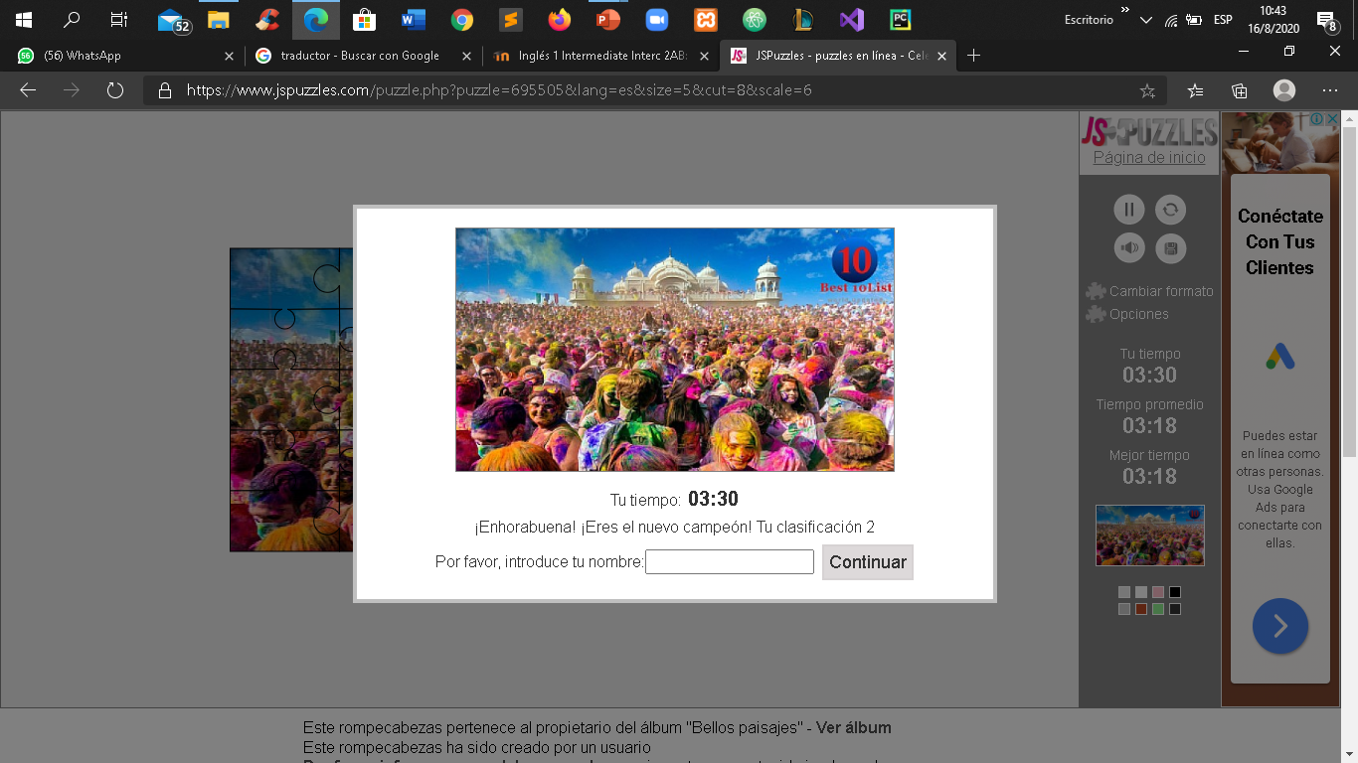
Week 1: Question about a song & activity voice
All the activities of this week were answered in the lesson of that week.
And a puzzle was made

Slide 3
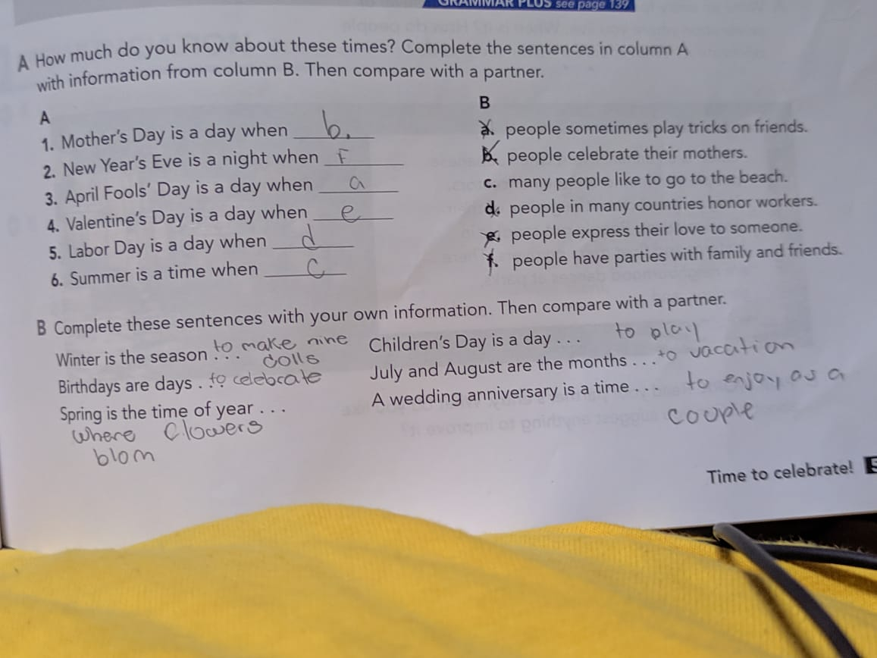
Week 2: Answer the question, page 51

Slide 4
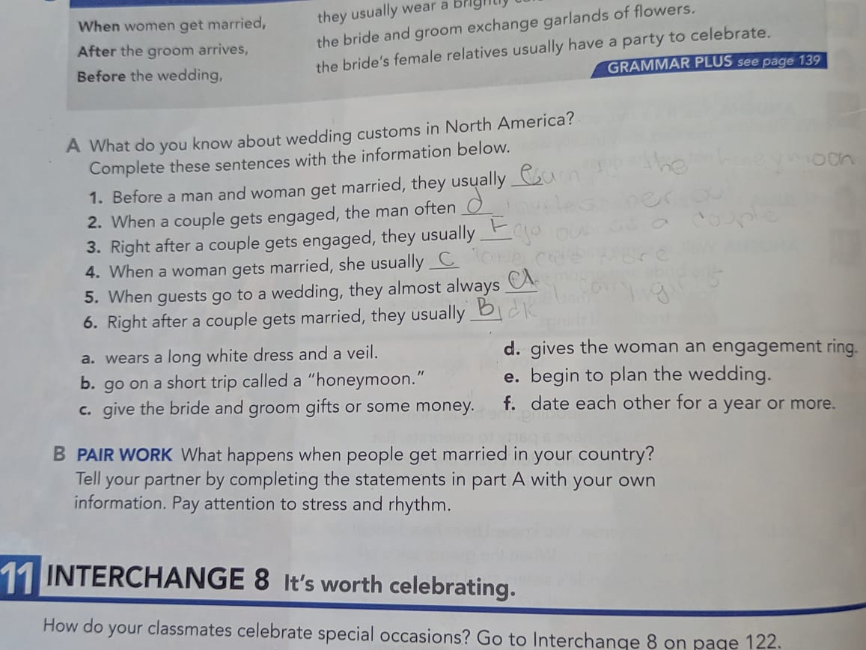
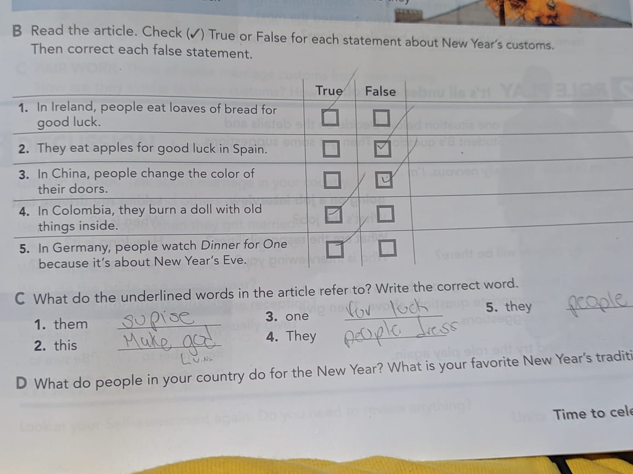
Page 54, 55

Slide 5
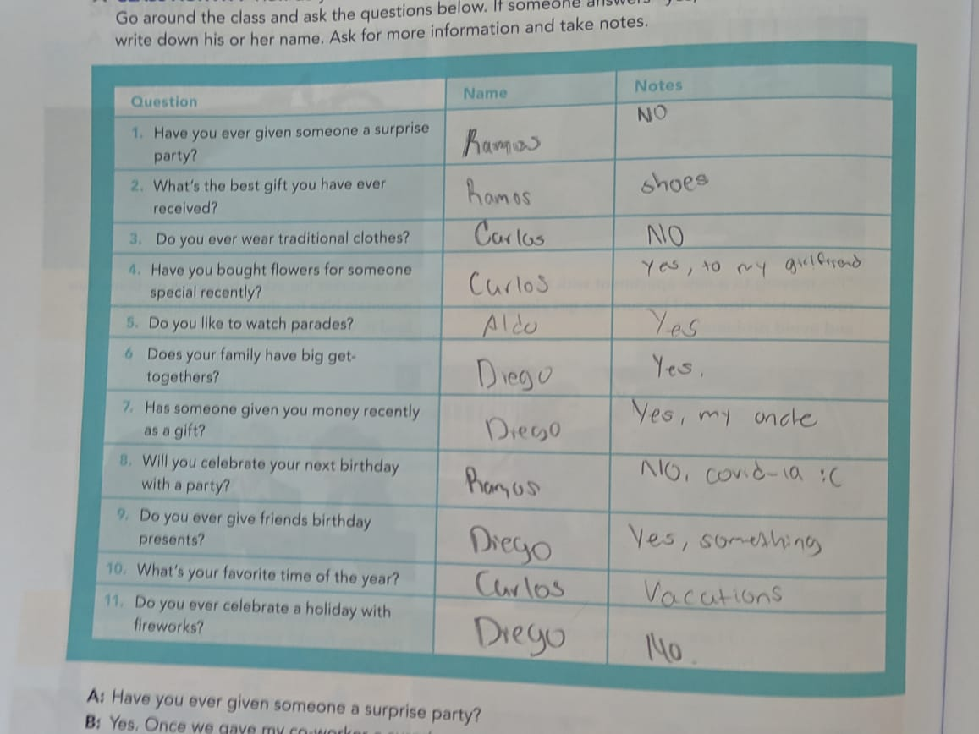
page 122

Slide 6
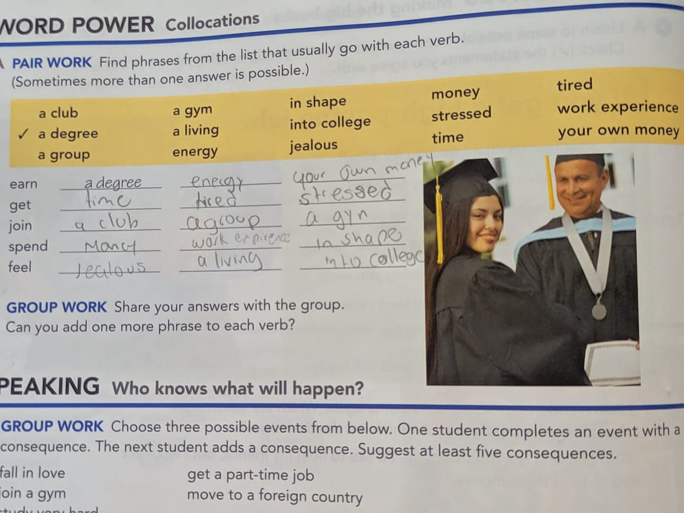
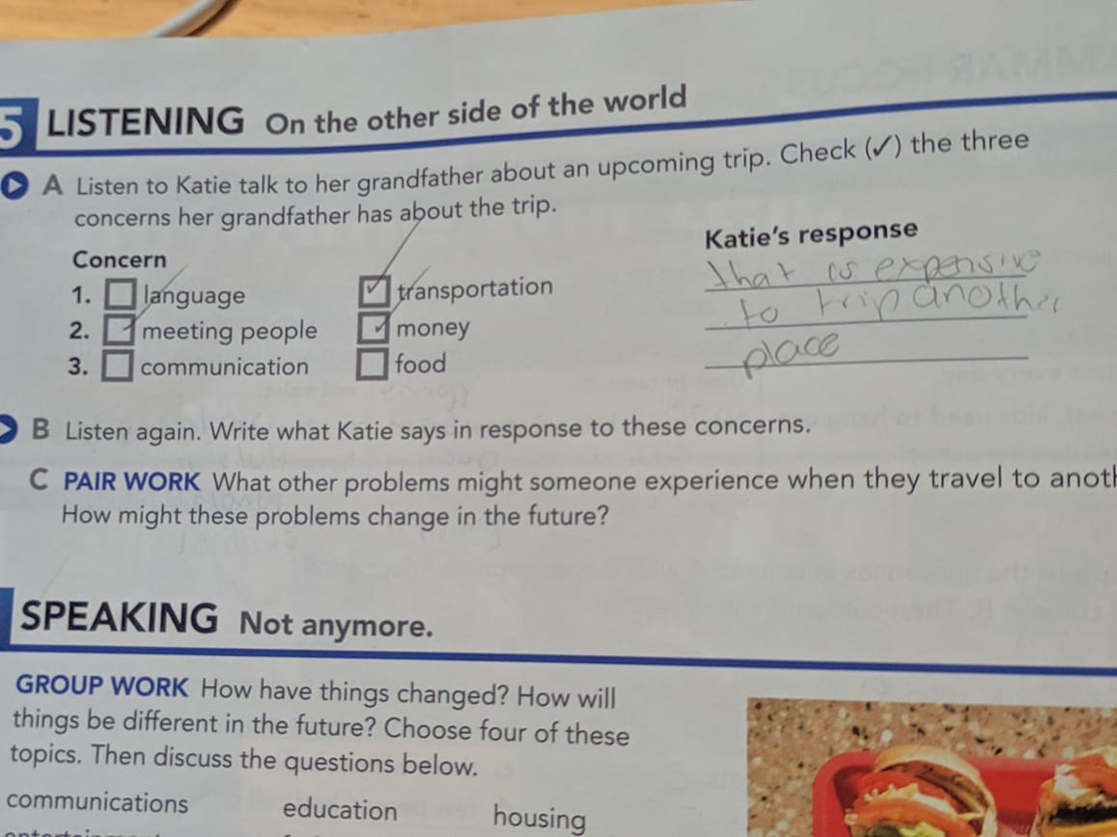
Week 3: “Hear me now” and answers
The activities of this week are answered in the lesson carried out.
page: 60, 62

Slide 7
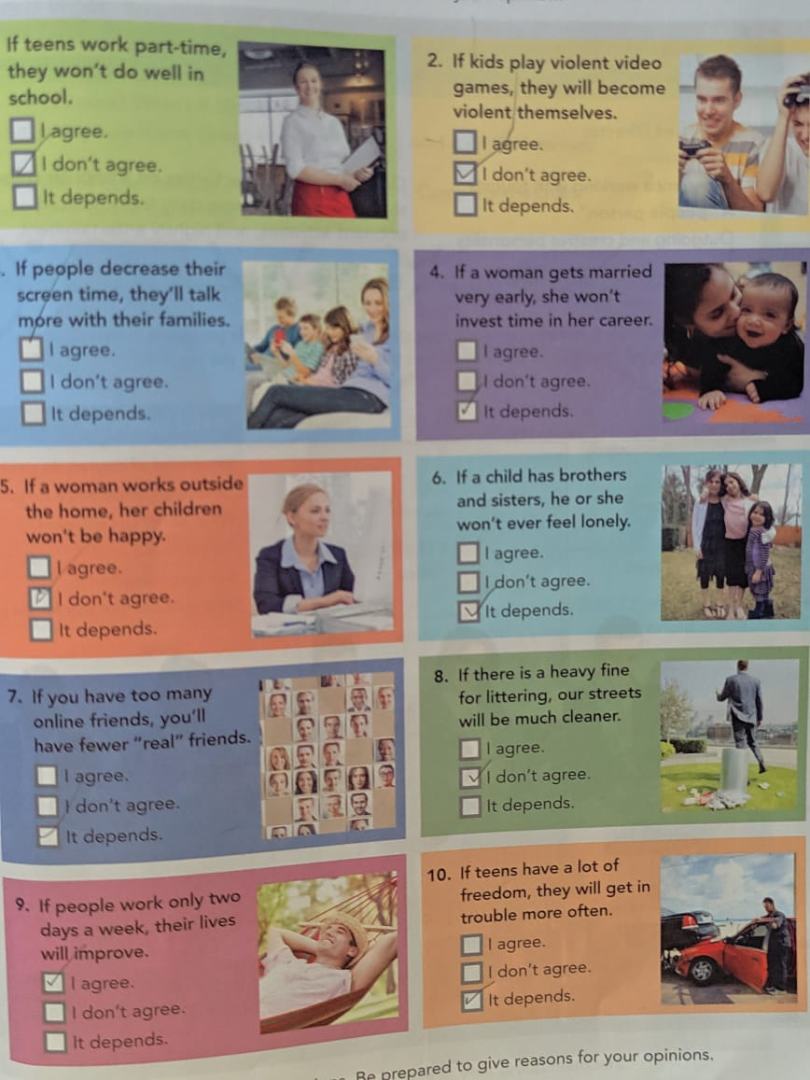
page 123 & Reading guide.

Slide 8
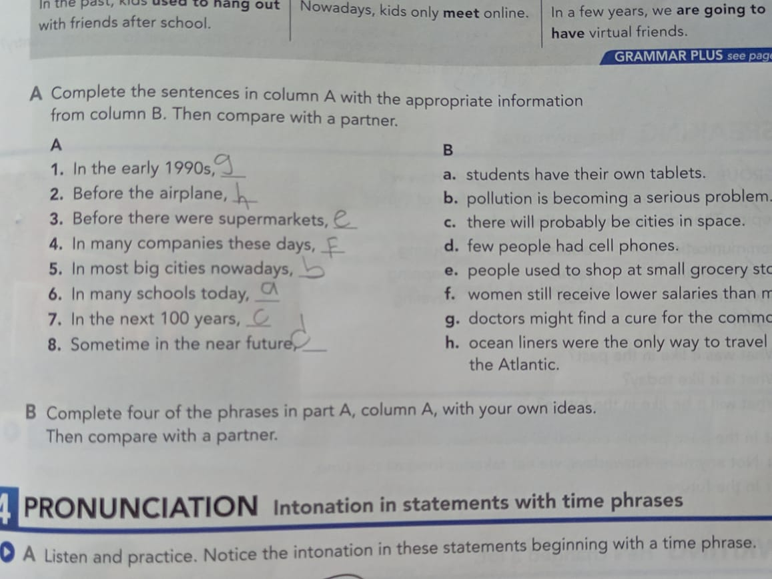
Week 4: Carl and Ellie´s storie / Page 59

Slide 9
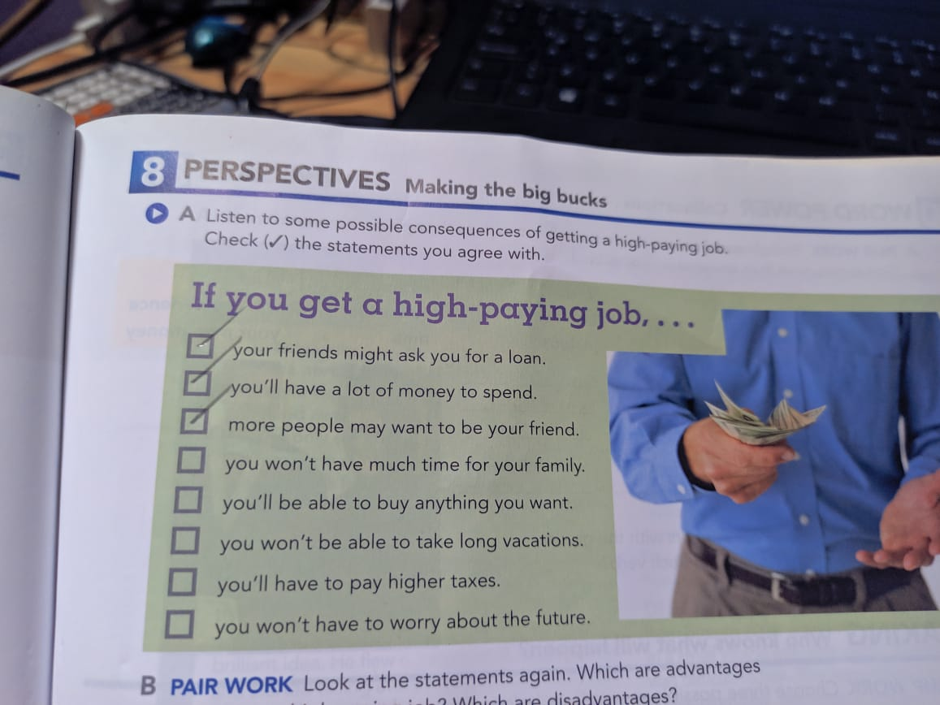
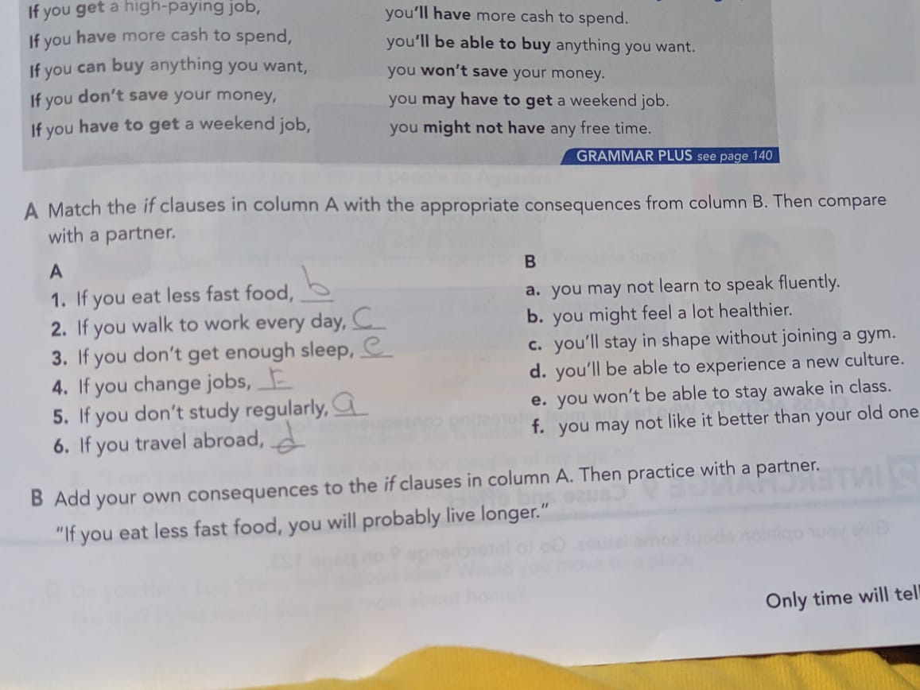
Page 61 part 8

Slide 10
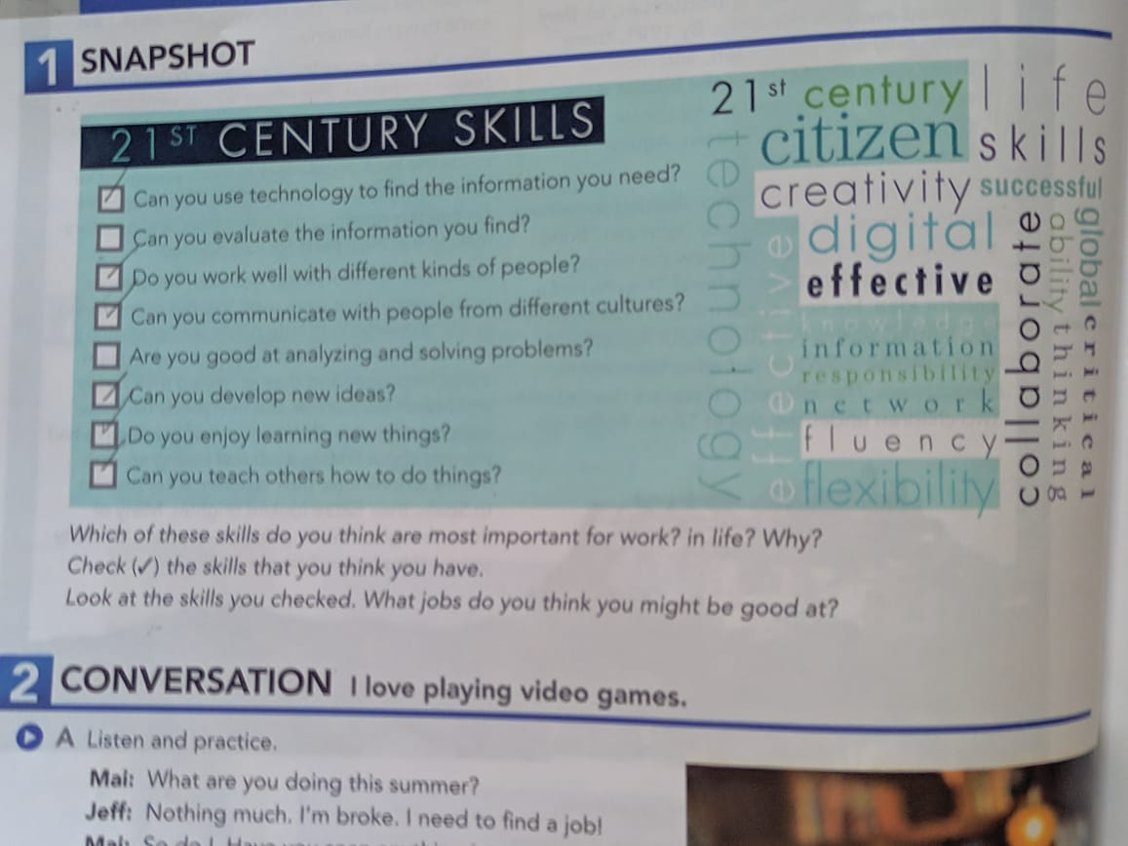
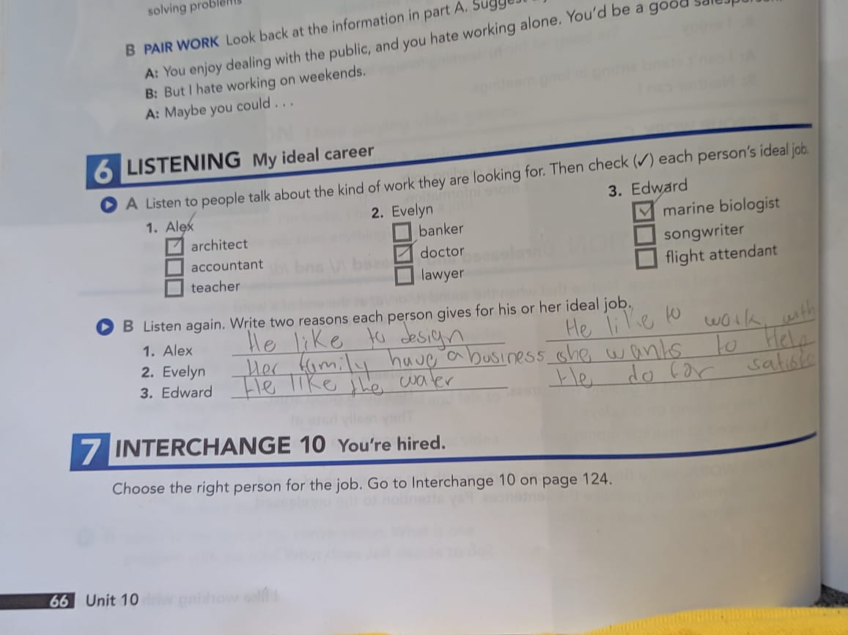
Week 5: Page 64, 66

Slide 11
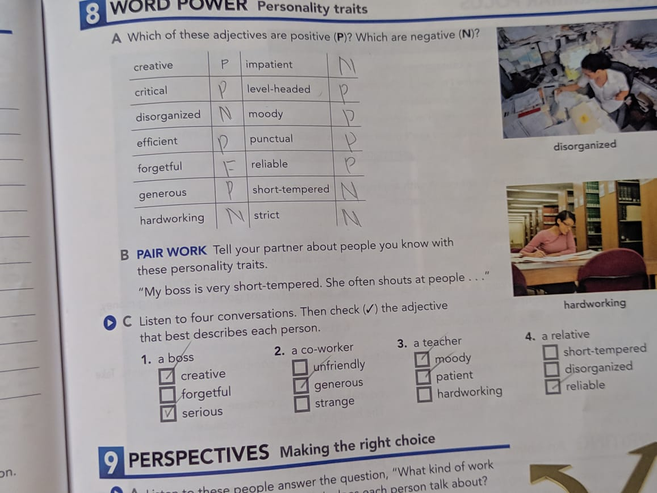
page 67

